Slide 1


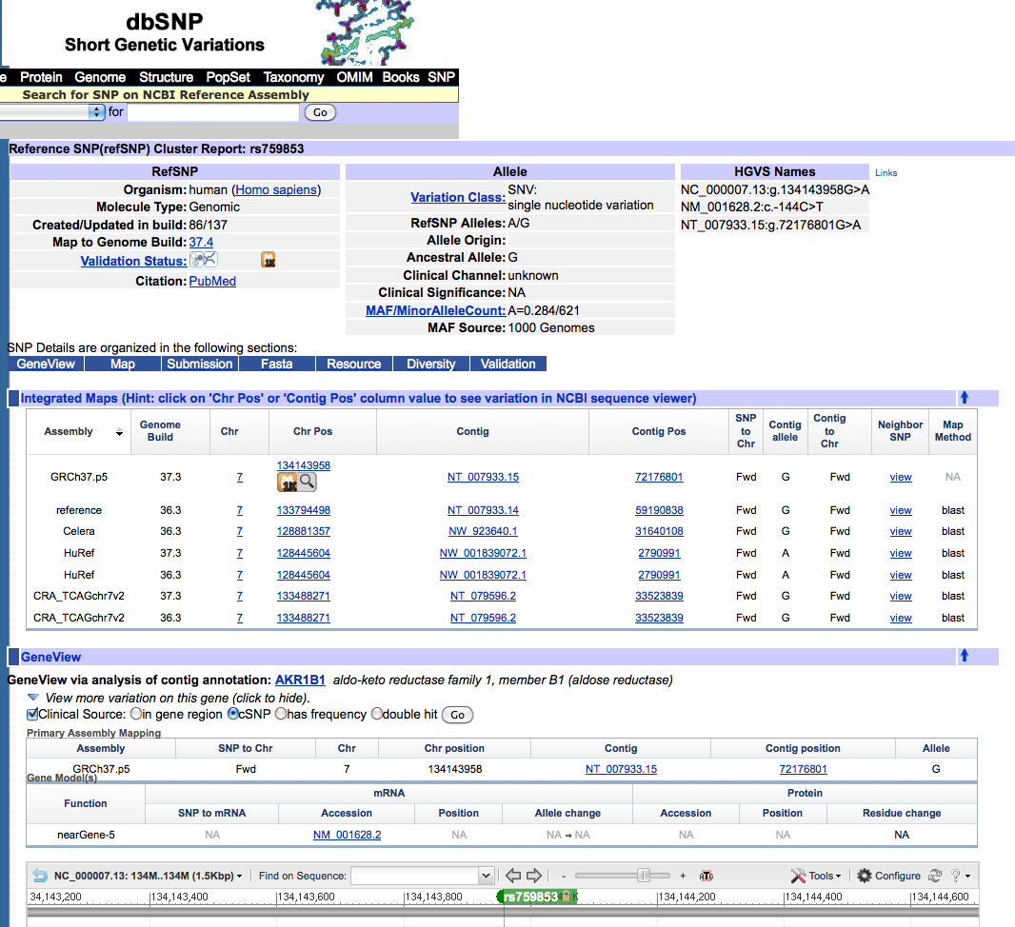
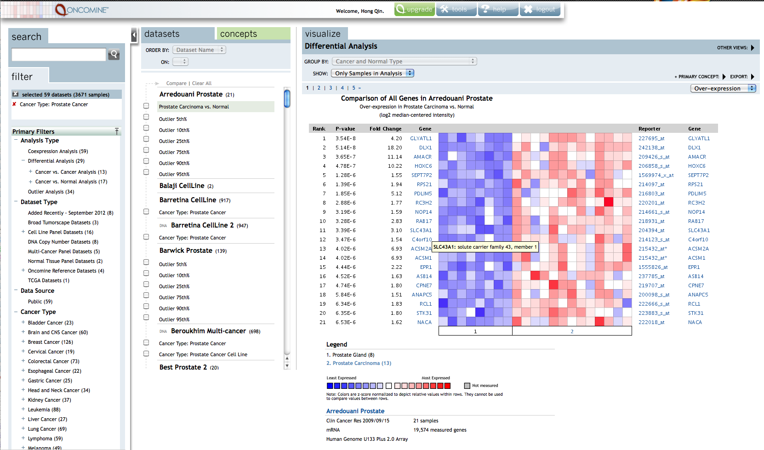
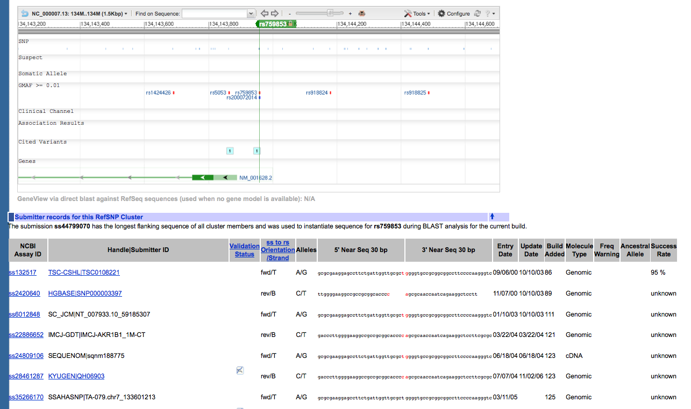
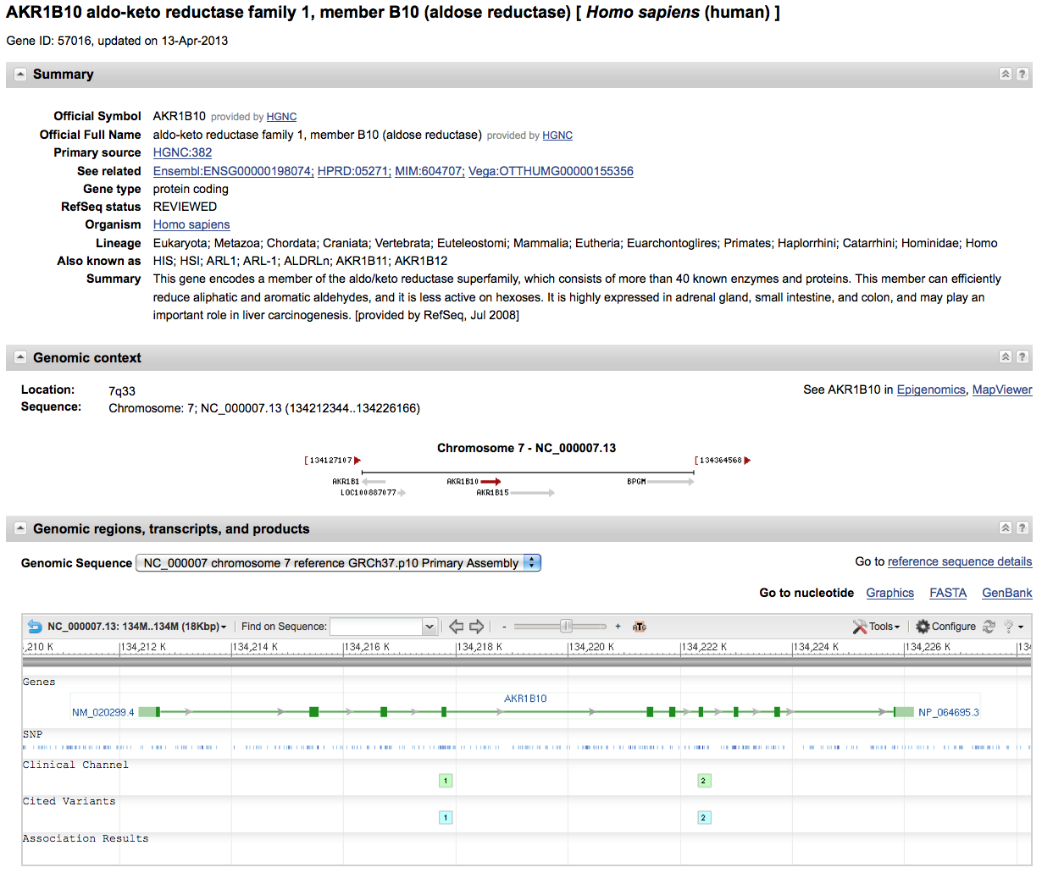
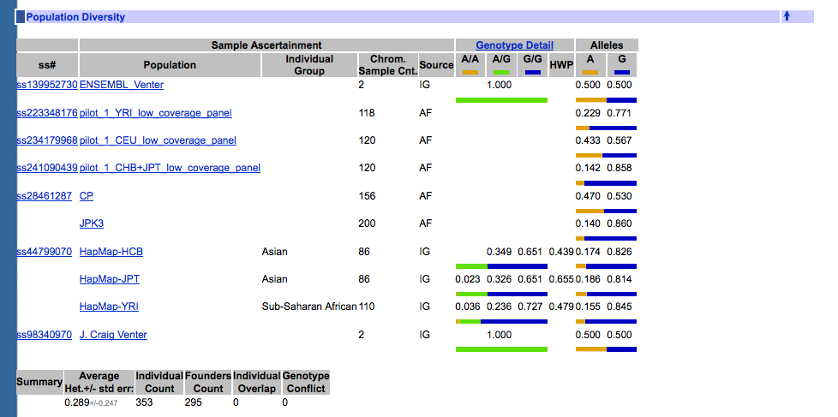
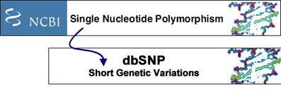



Bioinformatics Analysis of Human Genes Associated with Health-disparity Related Diseases
Daria Clegg, Mislie Jean-Baptiste, Dr. Hong Qin, PhD. Spelman College Biology
ABSTRACT
SPECIFIC AIMS
Candidate Gene Examinations
Polymorphisms in human genomes are known to be associated with health disparity related diseases. Our overall goal is to identify human genes associated with diseases at higher rates in African Americans. To achieve this goal, we are conducting a large-scale bioinformatics analysis on the NCBI dbSNP database. We are developing a Python program to analyze the allele frequencies in different human populations and investigate their association with human diseases. Meanwhile, we focus on a list of candidate genes that may be related to human disparity diseases. We specifically focused on the AR homolog in the human genomes and investigated their association with diabetes and lung cancer. We also compared the gene expression patterns in different human populations using Oncoming.org.
Aim 1. Perform large-scale computational searches to identify yeast homologs for candidate human genes that are under recent-selection in the in AADPs, and evaluate the population variation of these genes in yeast. We are especially interested in genes with copy-number variations (CNVs), climate-mediated selection, and exceptional longevity in humans.
Aim 2. Evaluate a list of candidate human genes and examine their allele distributions in African Derived Populations.AAPs..
METHODS AND RESULTS
OncoMine
INTRODUCTION
The human population houses multiple variants of any given gene, leading to polymorphism. No two humans are genetically identical and therefore have genetic differences. Polymorphisms in human genomes are known to be associated with diseases at higher rates in African Americans (DHRAA). Specifically, Sickle Cell Anemia is caused by mutations in the hemoglobin gene. This disease has a high-incidence in African American populations (AAPs) because of an adaptive advantage found in heterozygous carriers that yields resistance to malaria. These genetic variations underlie differences in our susceptibility to disease. Polymorphisms could be under selection and possibly outcomes of trade-off during evolution; thus we hypothesize that recently selected gene variants in AAPs may account for some DHRAA. Our long-term goal is to develop functional assays in the model organism of Saccharomyces cerevisiae for human genes associated with (DHRAA). We will retrieve the polymorphism data in these genes from The Single Nucleotide Polymorphysism database (dbSNP), which houses a broad collection of simple genetic polymorphisms. Extensible Markup Language (XML) and Python, a higher-level computer programming language, are used to analyze dbSNPs. Genomic data can be found in XML format and through the tools available through python, data can be abstracted and analyzed to pinpoint polymorphisms associated with DHRAA. Our focus will aim to evaluate a list of candidate human genes and examine their allele distribution in AAPs.
dbSNP
Computational Flow Chart
Summary
We are laying the ground work to search for candidate genes that are associated with health disparity related diseases.
Acknowledgements
Spelman ASPIRE
Spelman CHDRE Pilot Grant

